Slide 1
Deep Learning Lect#1
Quick Stats Refresher

Slide 2
Central Tendency
Mean, Mode and Median

Slide 3
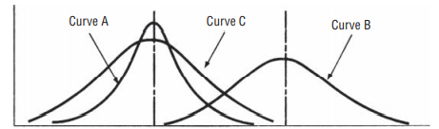
Central Tendency
Central tendency is the middle-point of a distribution

Slide 4
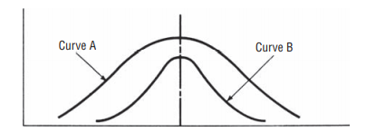
Dispersion
Dispersion is the spread of the data in a distribution

Slide 5
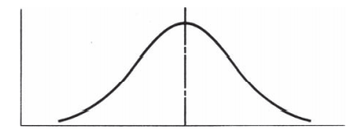
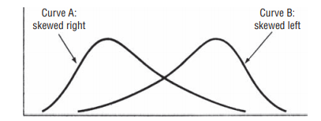
Symmetry and Skewness

Slide 6
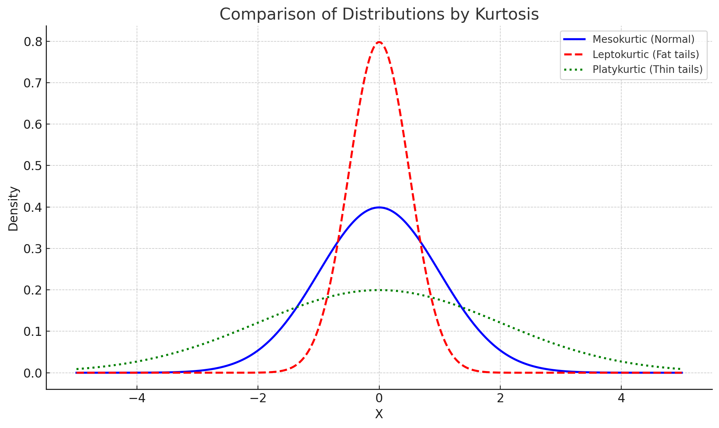
Kurtosis (A measure of peaked-ness and tailed-ness)
Notes:
Red-Higher peak than normal but heavy(longer) tails, so chances of finding outliers is also more. Green-Thin tails, the tails end faster than normal.

Slide 7
Mean
µ
Population Mean
Sample Mean
$$\overline{x}$$

Slide 8
Mean from ungrouped data
Student: 1 2 3 4 5 6 7
Percentile in GATE: 9 7 7 6 4 4 2
$$\overline{x}=\frac{\sum{x}}{n}$$
µ$=\frac{\sum{x}}{N}$
39/7

Slide 9
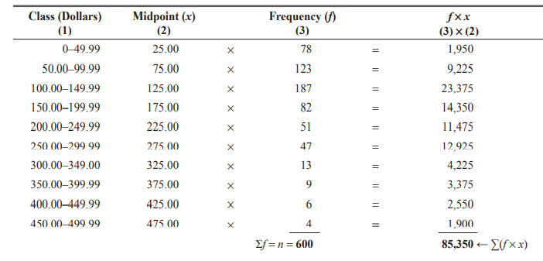
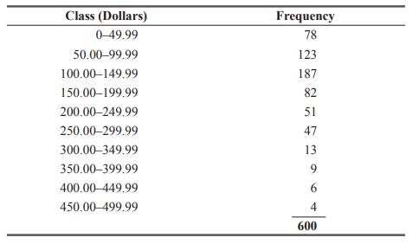



Mean in grouped-data
$\overline{x}=$?
Average monthly balance of 600 customers in a bank

Slide 10
Advantages of Mean
Single number representing the whole data set
Every data set has a mean and the mean is unique
Mean is useful for performing statistical procedures such as computing the mean from several data sets

Slide 11



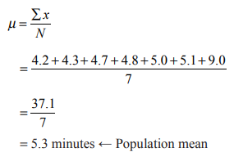
Disadvantages of Mean
Extreme Values
Open-ended Interval
Tedious to calculate with large number of ungrouped data

Slide 12
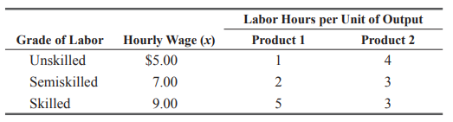
Weighted Mean
Average that takes into account the importance of each value
Average cost of labour per hour for each of the products?
$8/hour
$6.8/hour

Slide 13
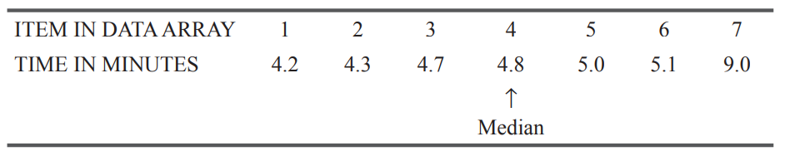
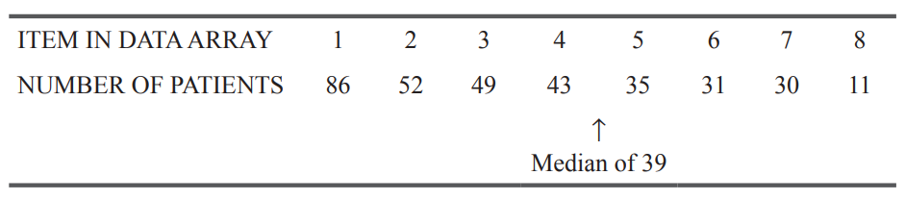
Median
Most central item in the set of numbers
Ungrouped data

Slide 14
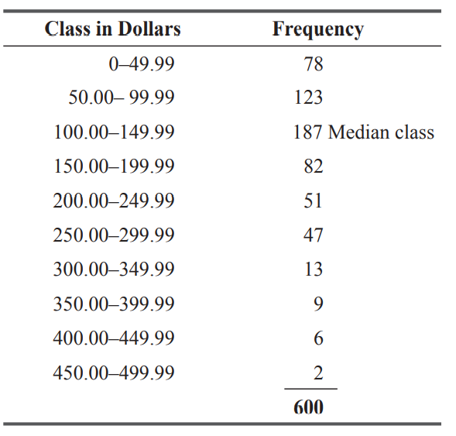

…Median
Grouped data

Slide 15
Advantages
Extreme values don’t affect the median as strongly as they do mean
Open-ended class doesn’t pose a problem to median, unless median falls in the open-ended class
Works even with qualitative data
Very Strong, Moderately-Strong, Strong, Weak, Very Weak

Slide 16
Disadvantages
Statistical procedures are complex with median than mean
Sorting is required before calculation of median
Mean is an easy estimate of the population parameter than median

Slide 17
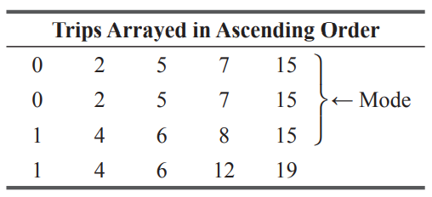
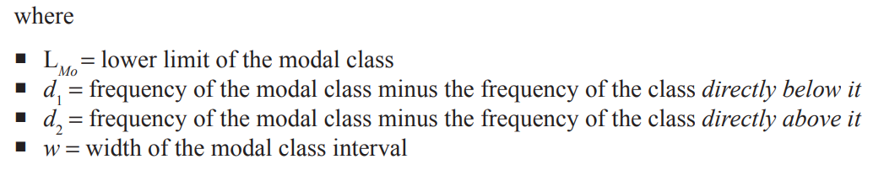
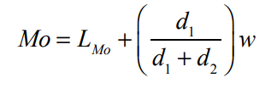
Mode
mean is 6.7
Value that is repeated most often in a data set
Never use mode for ungrouped data
In case of Grouped data, Mode=
Class with the largest frequency is the modal class

Slide 18
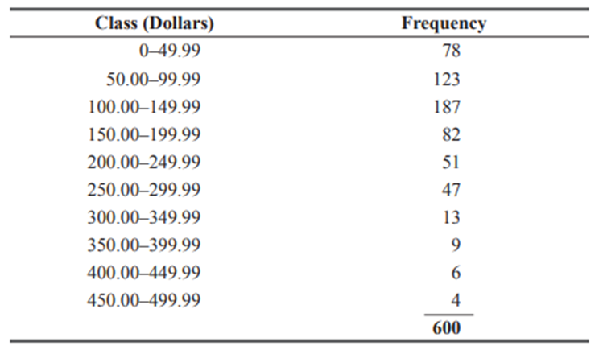
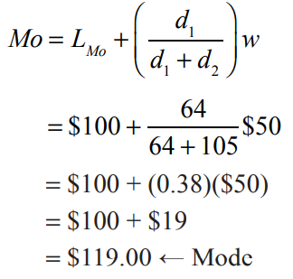
Exercise

Slide 19
Advantages & Disadvantages
Advantages
Can be used as central tendency
Extreme values doesn’t affect mode
Can work with open-ended classes
Disadvantages
Despite these advantages, mode is not as popular as median or mean
Also, too often data set doesn’t has values that are repeating
Every value may be the mode
When data sets contain two, three or more modes, they are hard to interpret and compare

Slide 20
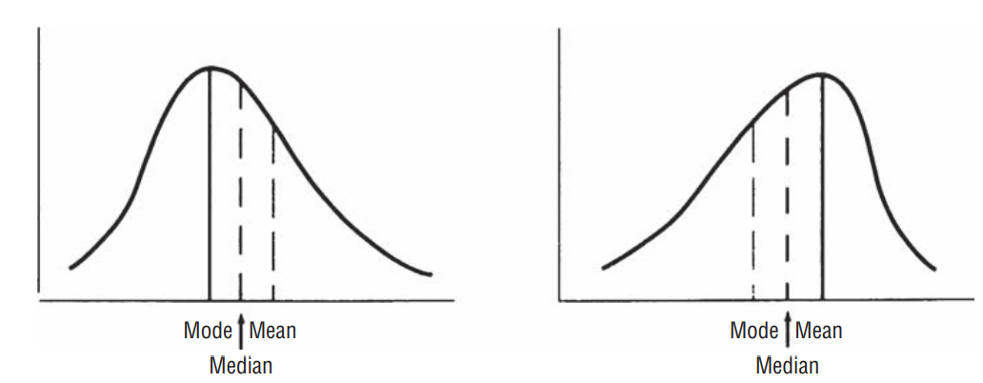
Comparing mean, median and mode
Mean, Median and Mode are identical in a symmetric distribution
When data is skewed, median is better
Median is not affected by extreme values (as in mean) and it is no influenced by the frequency of occurrence of a single value (as in mode)

Slide 21
Another Example why median is insensitive to outliers
Suppose five people earn:
₹30k, ₹35k, ₹40k, ₹45k, ₹1 crore
Mean salary ≈ ₹21.0 lakh — looks like everyone is rich.
Median salary = ₹40k — shows a more realistic typical income.

Slide 22
Dispersion

Slide 23
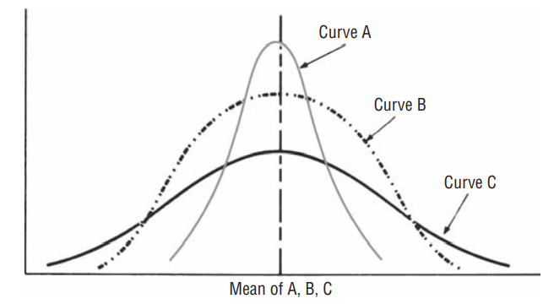
Why dispersion is important?
To increase our understanding of the data pattern, we must know its dispersion-its spread, or variability
Mean is same for all the three curves, but
variability of A is less than B than C
Mean, median or mode gives partial info
Central tendency is less representative in C
Financial use: Stock prices that possess large variance are risky
Quality control: A drug that is average in purity but ranges from very pure to highly impure may endanger lives

Slide 24
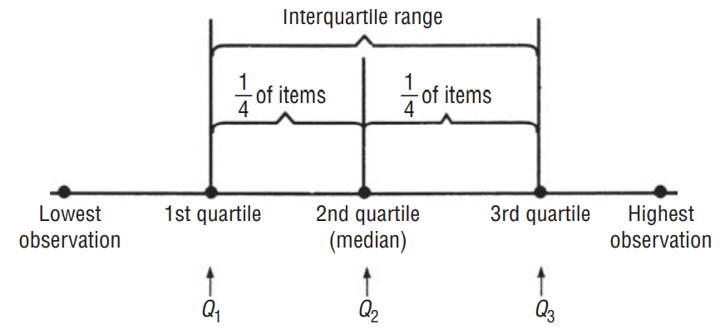
Measures of dispersion
Range
Maximum observation – minimum observation
affected by extreme values
doesn’t work in open-ended class
doesn’t take into account all the observations
Interquartile Range
Percentile is dividing your range into
100 parts
I got 90 percentile in GATE?

Slide 25
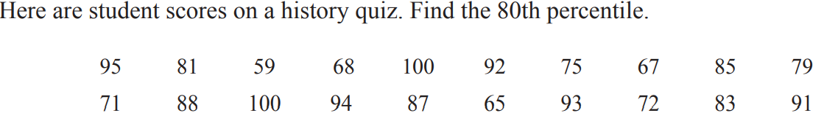
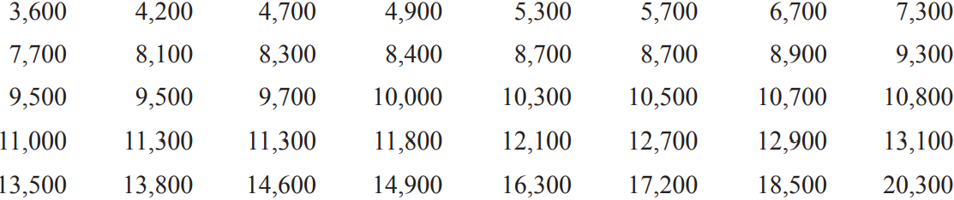
Exercises
Develop the Box Plot for the following data:
Notes:
Ans: 16th value i.e. 93 (of course after sorting)
Ans: 3600, 8100, 10150, 12700, 20300

Slide 26
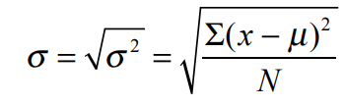
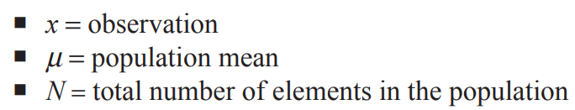
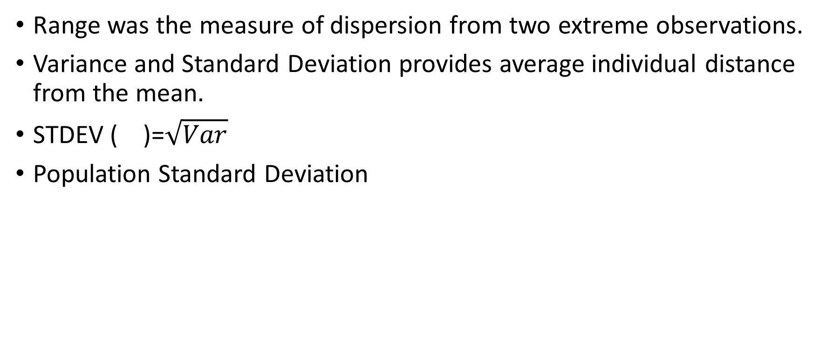
Average distance of individual observations from the mean
Range was the measure of dispersion from two extreme observations.
Variance and Standard Deviation provides average individual distance from the mean.
STDEV ( )=$\sqrt{Var}$
Population Standard Deviation

Slide 27
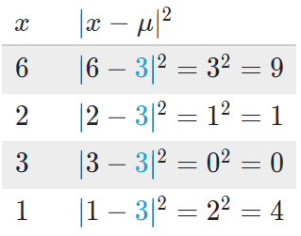
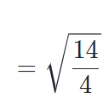

Exercise
Find the standard deviation for the following data: 6, 2, 3, 1

Slide 28
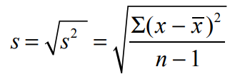

Sample standard deviation
µ
$$\overline{x}$$
N
n-1

Slide 29

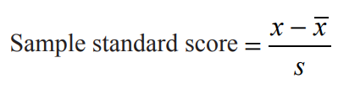
Standard Score
Standard score (z-score) gives us the number of standard deviations an observation lies above or below the mean
Consider the data: 6, 2, 3, 1
How many standard deviation is 6 apart from the mean?
Notes:
3/1.87=1.60

Slide 30
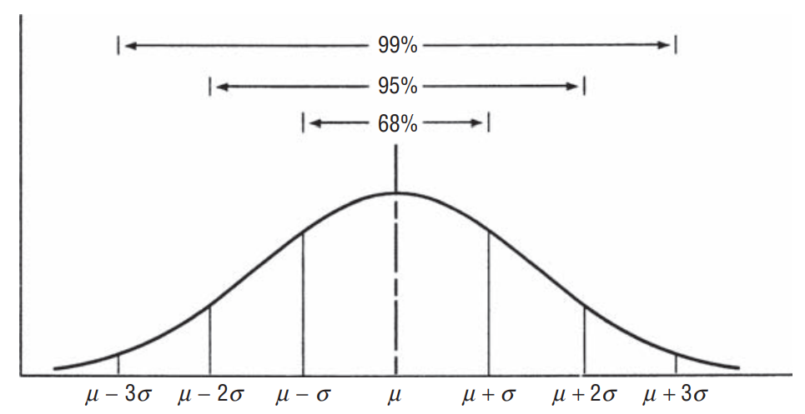
Chebyshev’s Theorem
No matter what the shape of the distribution is: at least 75 percent values lie within ± 2 Standard Deviations from the mean, and at least 89 percent values lie within ± 3 Standard Deviations from the mean.
In case of symmetrical bell-shaped curve:

Slide 31
Exercise
59.8, 73.8
A set of 60 observations has a mean of 66.8, a variance of 12.60, and an unknown distribution shape
Between what values should at least 75 percent of the observations fall, according to Chebyshev’s theorem?
57
If the distribution is symmetrical and bell-shaped, approximately how many observations should be found in the interval 59.7 to 73.9?
Find the standard scores for the following observations from the distribution: 61.45, 75.37, 84.65, and 51.50
-1.51, 2.41, 5.03, -4.31

Slide 32
Central Limit Theorem
The sampling distribution of the sample mean approaches a normal distribution as the sample size increases, regardless of the shape of the population distribution.
As sample size n increases, the distribution of sample means becomes approximately normal.
Mean of sampling distribution = population mean (μ).
Standard deviation of sampling distribution = σ / √n (Standard Error).
Implication:
Works for any population with finite mean (μ) and variance (σ²).
Allows use of normal-based inference (e.g., confidence intervals, hypothesis testing) even when the population is not normally distributed.

Slide 33
Types of estimates
Two types of estimates: Point estimate and Interval estimate
A point estimate is a single number that is used to estimate an unknown population parameter.
A point estimate is often insufficient, because it is either right or wrong.
An interval estimate is a range of values used to estimate a population parameter. It indicates the error in two ways: by the extent of its range and by the probability of the true population parameter lying within that range.

Slide 34
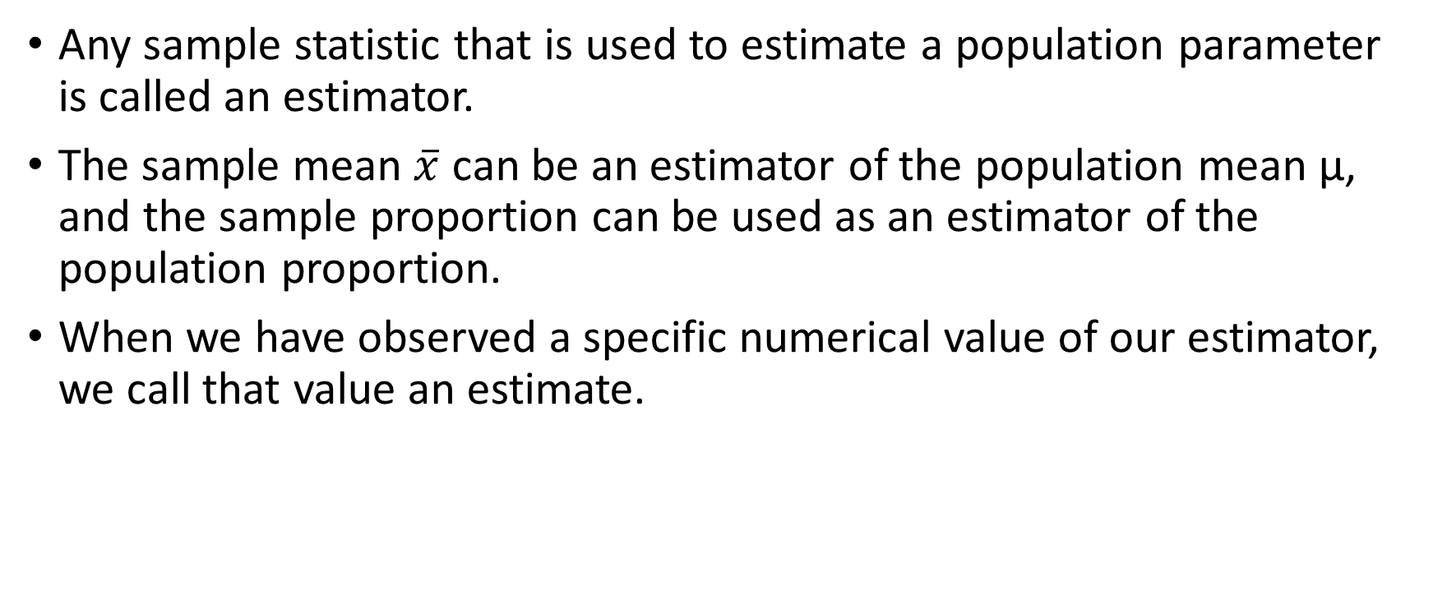
Estimator and Estimates
Any sample statistic that is used to estimate a population parameter is called an estimator.
The sample mean $\overline{x}$ can be an estimator of the population mean μ, and the sample proportion can be used as an estimator of the population proportion.
When we have observed a specific numerical value of our estimator, we call that value an estimate.

Slide 35
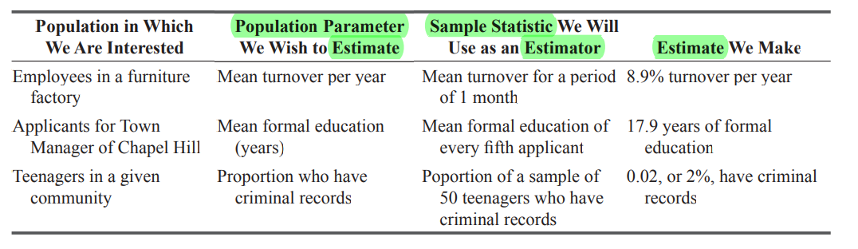
Populations, Population parameter, Sample Estimators, Sample Estimates

Slide 36
Confidence Level and Confidence Intervals
The confidence interval is the range of the estimate we are making. If we report that we are 90 percent confident that the mean of the population of incomes of people in a certain community will lie between $8,000 and $24,000, then the range $8,000–$24,000 is our confidence interval, and 90% is our level of confidence.
“We are 95 percent confident that the mean battery life of the population lies within 30 and 42 months.”
This statement does not mean that the chance is 0.95 that the mean life of all our batteries falls within the interval established from this one sample. Instead, it means that if we select many random samples of the same size and calculate a confidence interval for each of these samples, then in about 95 percent of these cases, the population mean will lie within that interval.
Notes:
Suppose you have a sample size of one. Chances are that this sample may fall in the outside of 95% interval range of the population main. So saying that there are 95% chance that this interval contains population mean can’ be said correct; however, if we take so many samples then the mean of those samples will be near the population mean, and the above ‘not so correct statement’ will gain some value. So the better interpretation is the second one. But first is how many people understand confidence level.

Slide 37
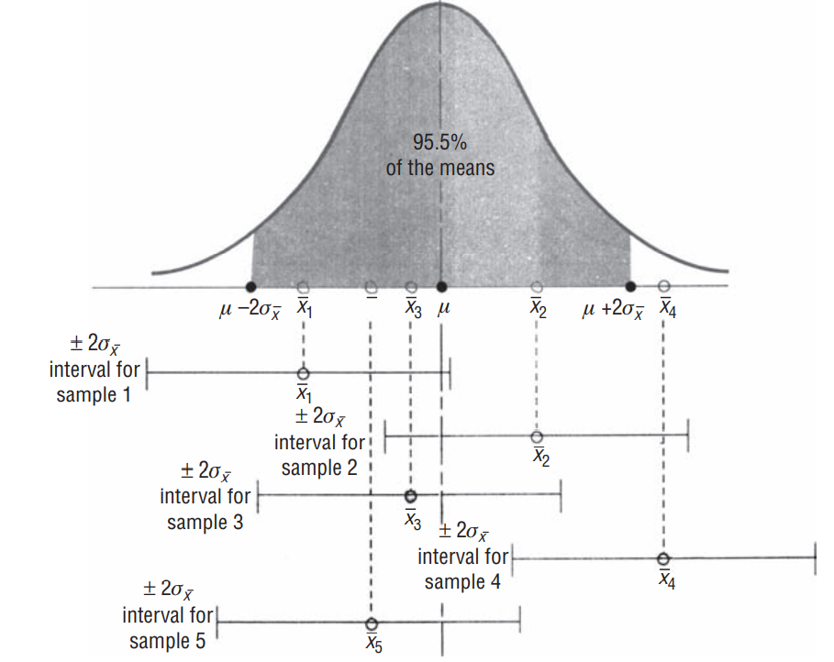
Confidence Interval Interpretation

Slide 38
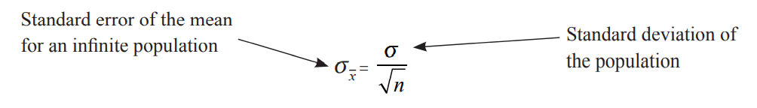
Problem 1
For a population with a known variance of 185, a sample of 64 individuals leads to 217 as an estimate of the mean.
(a) Find the standard error of the mean.
(b) Establish an interval estimate that should include the population mean 68.3 percent of the time.
Notes:
1.7 and [215.3, 218.7]

Slide 39


Problem-2
Given the following confidence levels, express the lower and upper limits of the confidence interval for these levels in terms of and σ . (a) 54 percent. (b) 75 percent. (c) 94 percent. (d) 98 percent
$$\overline{x}$$
$$\overline{x}$$

Slide 40
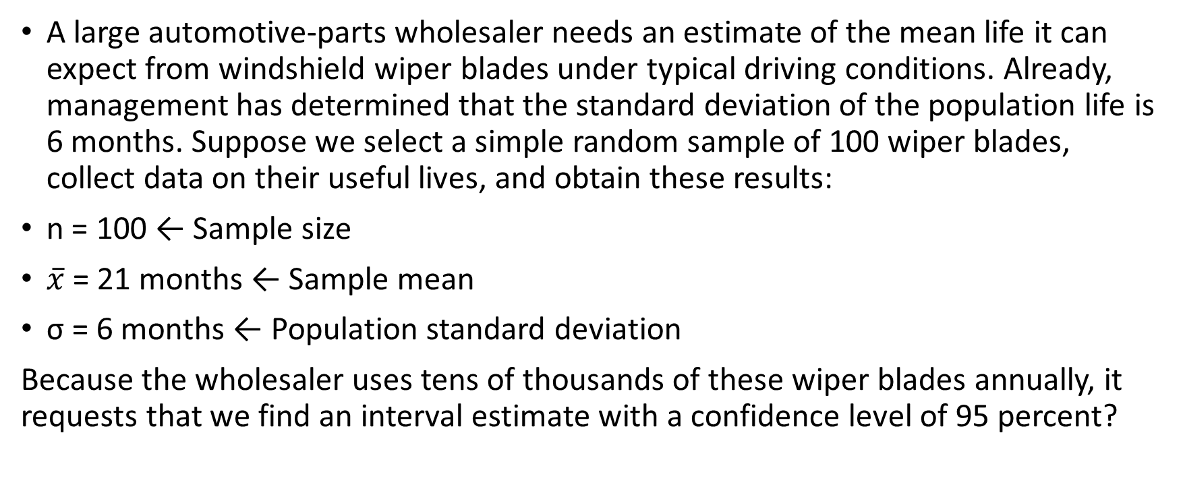
Problem-3
A large automotive-parts wholesaler needs an estimate of the mean life it can expect from windshield wiper blades under typical driving conditions. Already, management has determined that the standard deviation of the population life is 6 months. Suppose we select a simple random sample of 100 wiper blades, collect data on their useful lives, and obtain these results:
n = 100 ← Sample size
$\overline{x}$ = 21 months ← Sample mean
σ = 6 months ← Population standard deviation
Because the wholesaler uses tens of thousands of these wiper blades annually, it requests that we find an interval estimate with a confidence level of 95 percent?
Notes:
21+1.96(0.6) and 21-1.96(0.6)

